Slide 1

CIS9340
Principles of Database Management

Slide 2
CIS9340
Principles of Database Management
GROUP 6
GROUP 6
Notes:
#3C4B99
#D14A2B

Slide 3




GROUP 6
Miguel Rivas
Back End Developer
Balakumaran Kannan
Product manager
Matthew Martinez
Data Analyst
Chhejom Sherpa
UI/UX Designer

Slide 4
What is Mediblend?
Mediblend focuses on building health-based applications to cater to needs of patients and various health care providers
Help in providing solutions to client specific projects
Real time tracking of updates related to confidential medical information
Business Intelligence Reports on demand by participating entities

Slide 5
Requirements
List of Healthcare providers
List of Health insurance providers
Invoice History
Medical History
Patient history
Pharmacies registered in mediblend
Patient details
ICD-9 and ICD-10 codes built into database
Choice of Database management system: MySQL Workbench
Login design and access control based on the role (account) in the application: patient, doctor, pharmacist, insurance representative

Slide 6
Cost
Hardware Costs: Costs related to database servers, desktop computers, tablets/laptops, etc.
DBMS software Costs: Costs related to the application and various interfacing modules in the DBMS.
Tech Support and Implementation Assistance Costs: Costs related to IT Contractor, Attorney, Consultant, Hardware/Network Installation as well as teams dedicated maintenance for the lifecycle of the DB
Training Costs: Training the related physicians, nurses, and office staff to use the new software for inputting, reading, and modifying data.
Additional Maintenance and support fee: Depends on the SLA agreement of the Software firm and Health care provider.
Marketing is required for organizations and patients to adopt the application

Slide 7
Benefits
Patients have quick and easy access to medical history when needing to supply new providers with their medical history
Can speed up admissions into medical offices such as emergency rooms as some patients struggle to remember their medical history
Payment management would be easier as oftentimes different medical offices use different apps to pay bills
Increased transparency patients now have more access to medication info, detailed surgical procedures, and other health related information in their chart
Patients can track their health history to avoid any incurable illness
Insurance and billing information is transparent as oftentimes patients are left in the dark about how or why there are certain charges and must go on a scavenger hunt with the hospital, provider and insurance company to get an answer

Slide 8
Risks
High upfront cost. the initial capital is high, can work in a scalable custom solution.
Change in government policies and framework regarding privacy and security can lead to unexpected costs in refreshing database structure
Security is important to keep hackers out of reach of sensitive patient information.
Resistance from patients to adopt the platform due to privacy concerns related to misuse of personal data and sharing without their consent (or issuing a weak blanket consent form). This can be made more transparent by notifying the patient who and when their records are accessed as well as the reasoning.
Errors in software that can lead to data corruption, data leaks, or billing mishaps

Slide 9
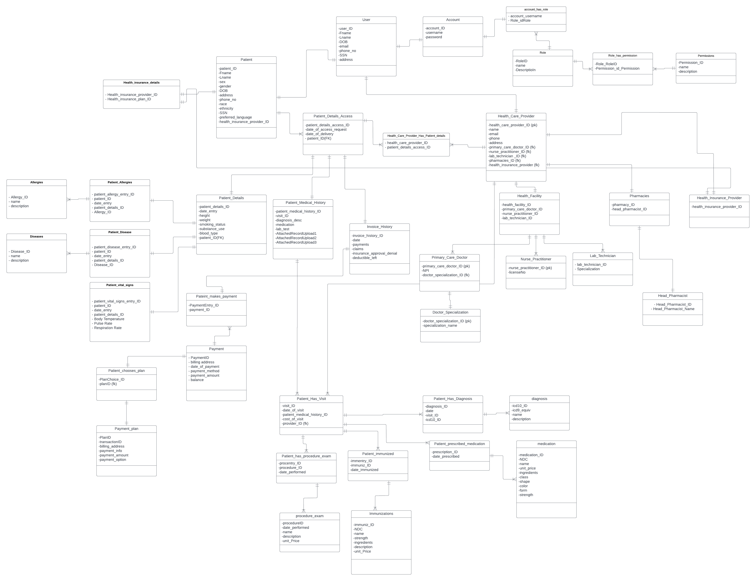
Project Implementation

Slide 10
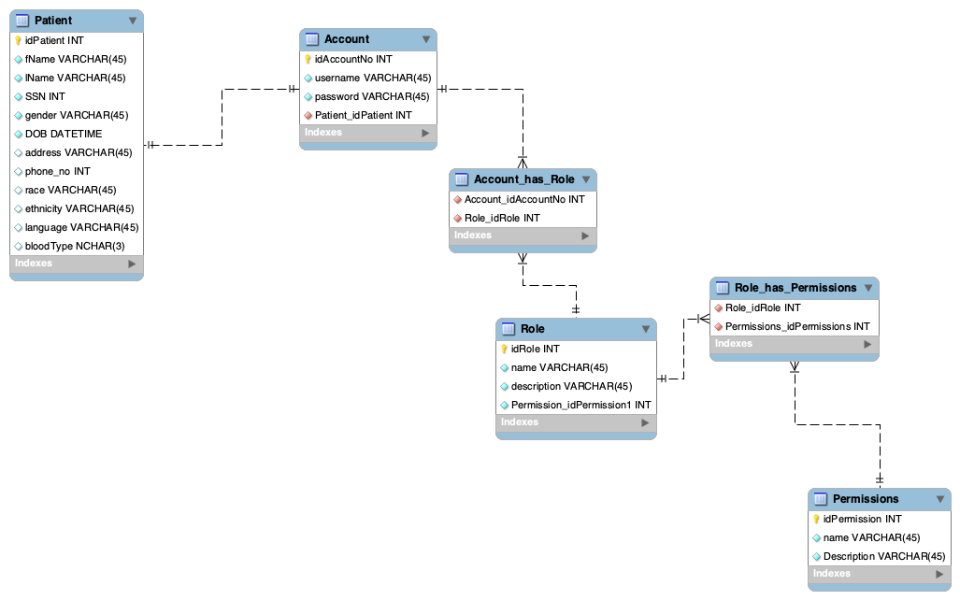
ACCOUNT
Notes:
Account

Slide 11
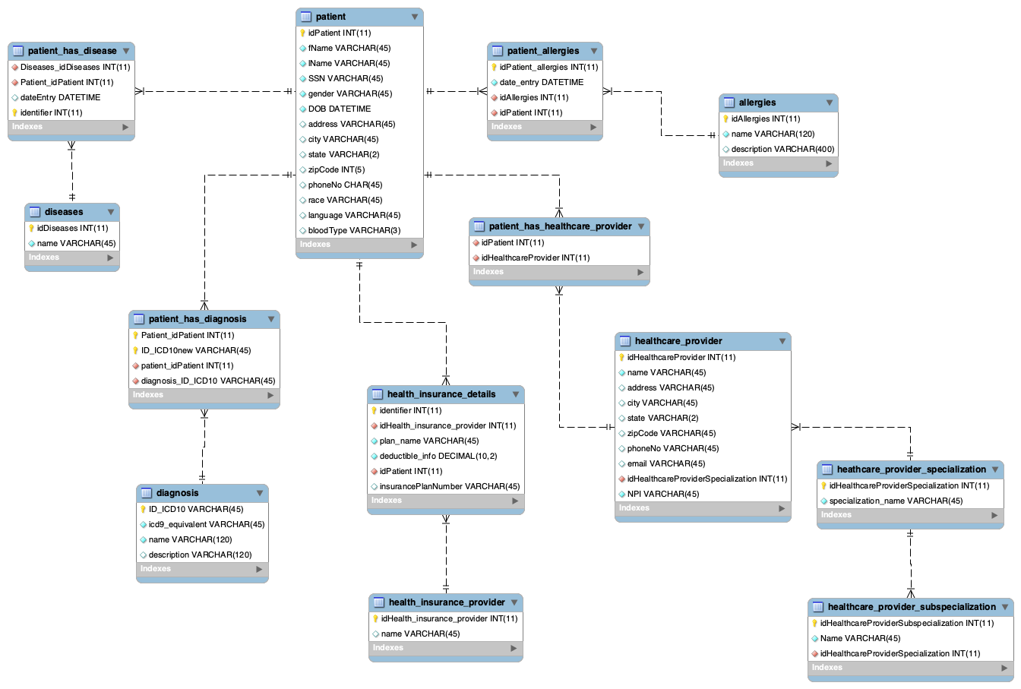
PATIENT
Notes:
payment

Slide 12
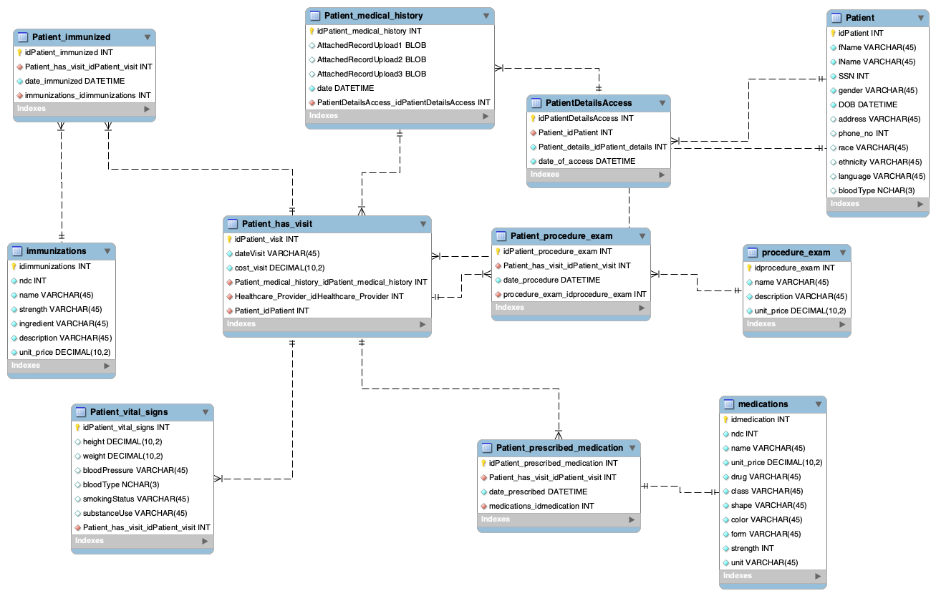
VISIT
Notes:
visit

Slide 13
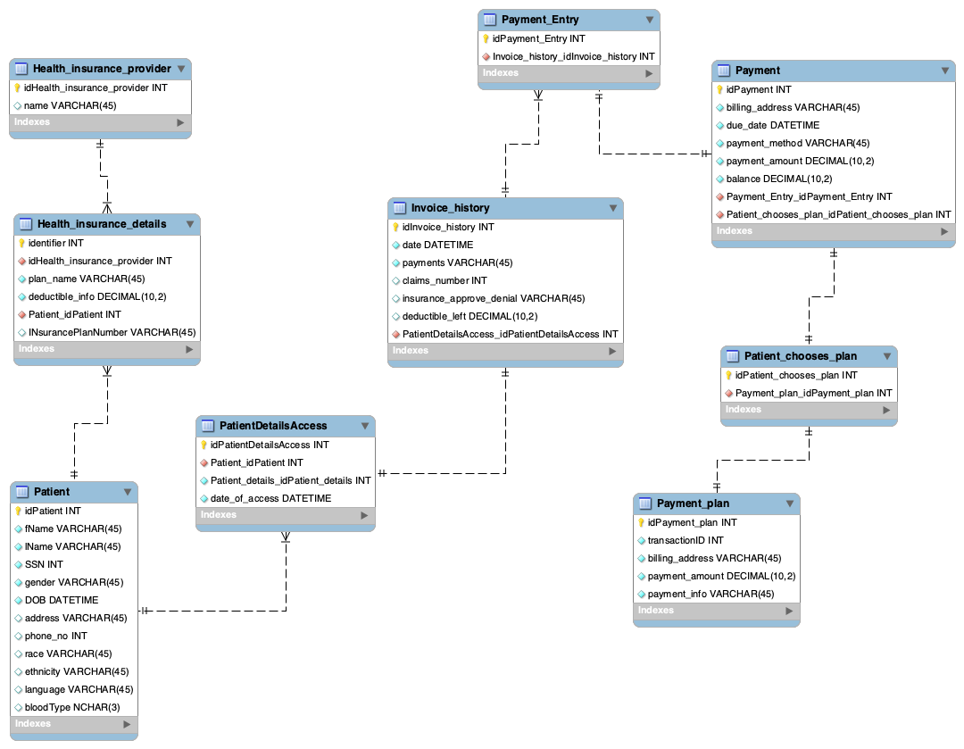
PAYMENT
Notes:
payment

Slide 14
Lookup patient and their health insurance details
SELECT p.fname AS PatientFirstName,
p.lname AS PatientLastname,
hid.plan_name AS HealthPlan,
hip.Name AS Insurance,
hid.deductible_info
FROM patient p
INNER JOIN Health_insurance_details hid ON p.idPatient = hid.idPatient
INNER JOIN Health_insurance_provider hip ON hip.idHealth_insurance_provider = hid.idHealth_insurance_provider;
Notes:
Bala

Slide 15
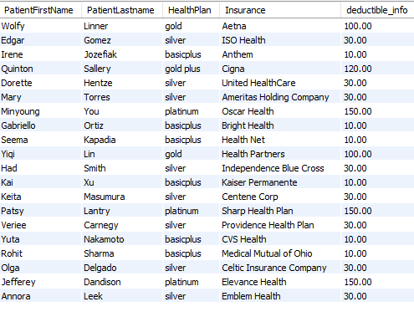
Lookup patient and their health insurance details​

Slide 16
Lookup patient's immunization for history on vaccines and recommend new
SELECT p.idPatient PatientId,
p.fName PatientFirstName,
p.lname PatientLastName,
Date(p.DOB) DOB,
Date(pim.date_immunized) ImmunizedDate,
im.name Name
FROM patient p
INNER JOIN patient_has_visit phv USING (idPatient)
INNER JOIN patient_immunized pim USING (idpatient_visit)
INNER JOIN immunizations im USING (idimmunizations)
ORDER BY fname;
Notes:
miguel

Slide 17
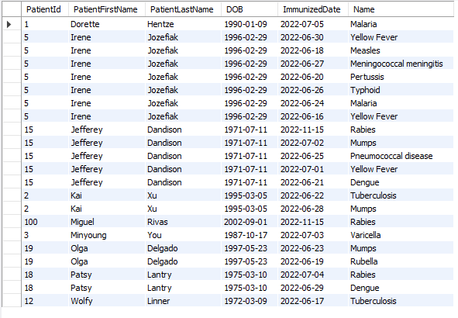
Lookup patient's immunization for history on vaccines and recommend new

Slide 18
Lookup patient's balance and amount due
SELECT p.idPatient AS PatientId,
p.fName AS PatientFirstname,
p.lName AS PatientLastName,
Date(p.DOB) AS PatientDOB,
pmt.balance AS AmtDue,
Date(pmt.due_date) AS AmtDueDate
FROM patient p
INNER JOIN patientdetailsaccess pda ON pda.idPatient = p.idPatient
INNER JOIN invoice_history ih ON ih.idPatientDetailsAccess = pda.idPatientDetailsAccess
INNER JOIN payment_entry pe ON pe.idInvoice_history = ih.idInvoice_history
INNER JOIN payment pmt ON pmt.idPayment_Entry = pe.idPayment_Entry
Notes:
matthew

Slide 19
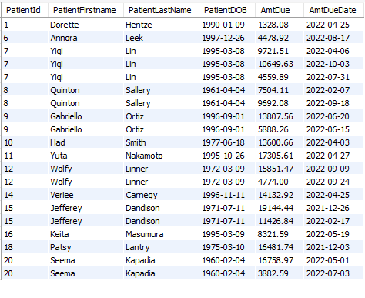
Lookup patient's balance and amount due​

Slide 20
Lookup patient and their healthcare provider name and specialization
SELECT p.idPatient AS PatientID,
p.fName AS PatientFirstName,
p.lName AS PatientLastName,
p.gender AS PatientGender,
Date(p.DOB) AS PatientDOB,
hp.name AS HealthCareProviderName,
hps.specialization_name AS Specialization
FROM patient p
INNER JOIN patient_has_healthcare_provider php ON php.idPatient = p.idPatient
INNER JOIN healthcare_provider hp ON hp.idHealthcareProvider = php.idHealthcareProvider
INNER JOIN heathcare_provider_specialization hps ON hps.idHealthcareProviderSpecialization = hp.idHealthcareProviderSpecialization
WHERE YEAR(DOB) > 1990
ORDER BY PatientFirstName;

Slide 21
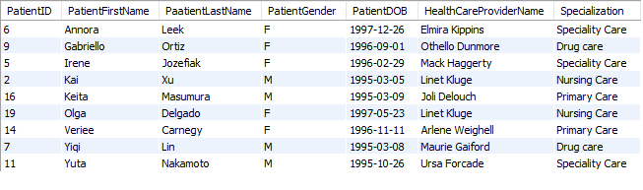
Lookup patient and their healthcare provider name and specialization

Slide 22
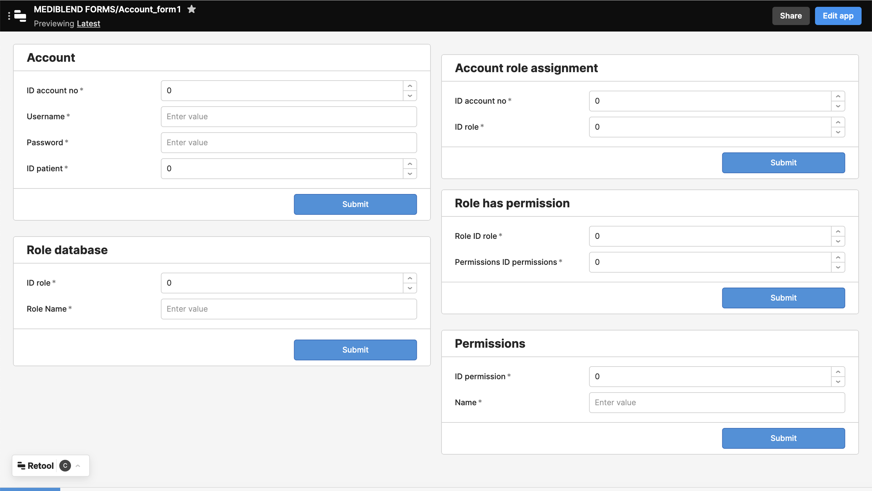

Slide 23
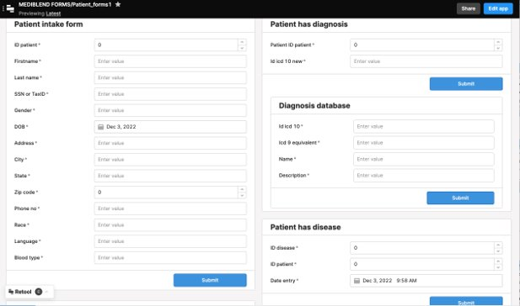
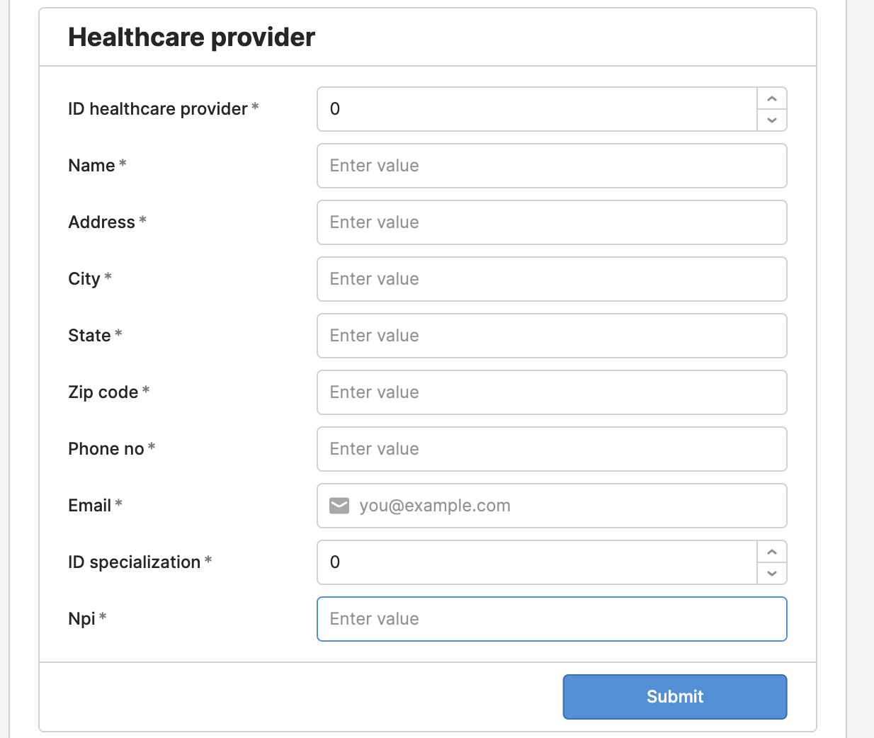
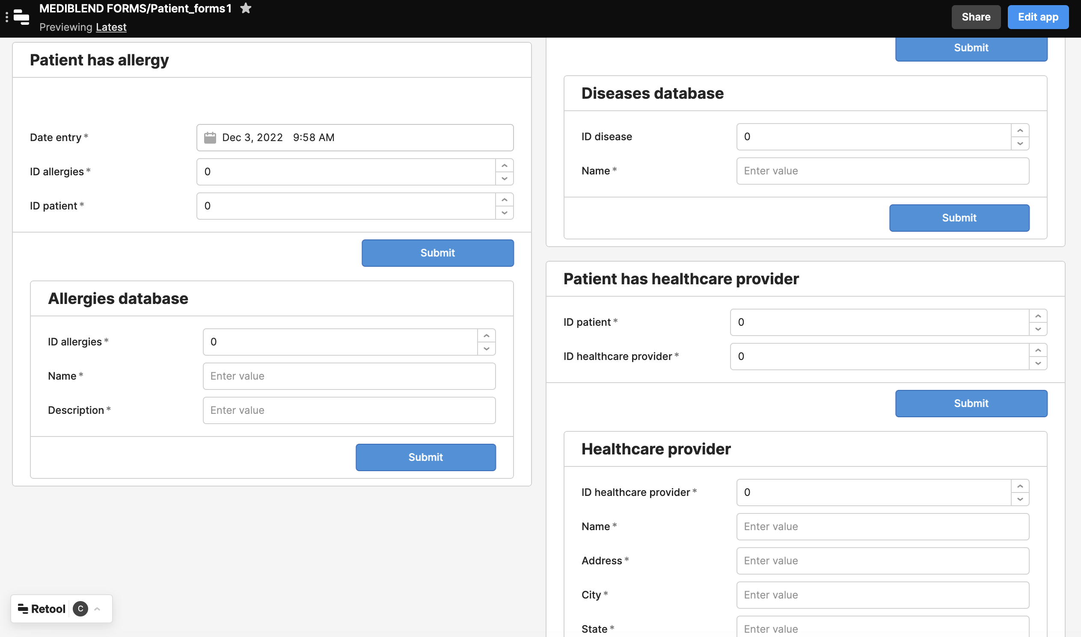
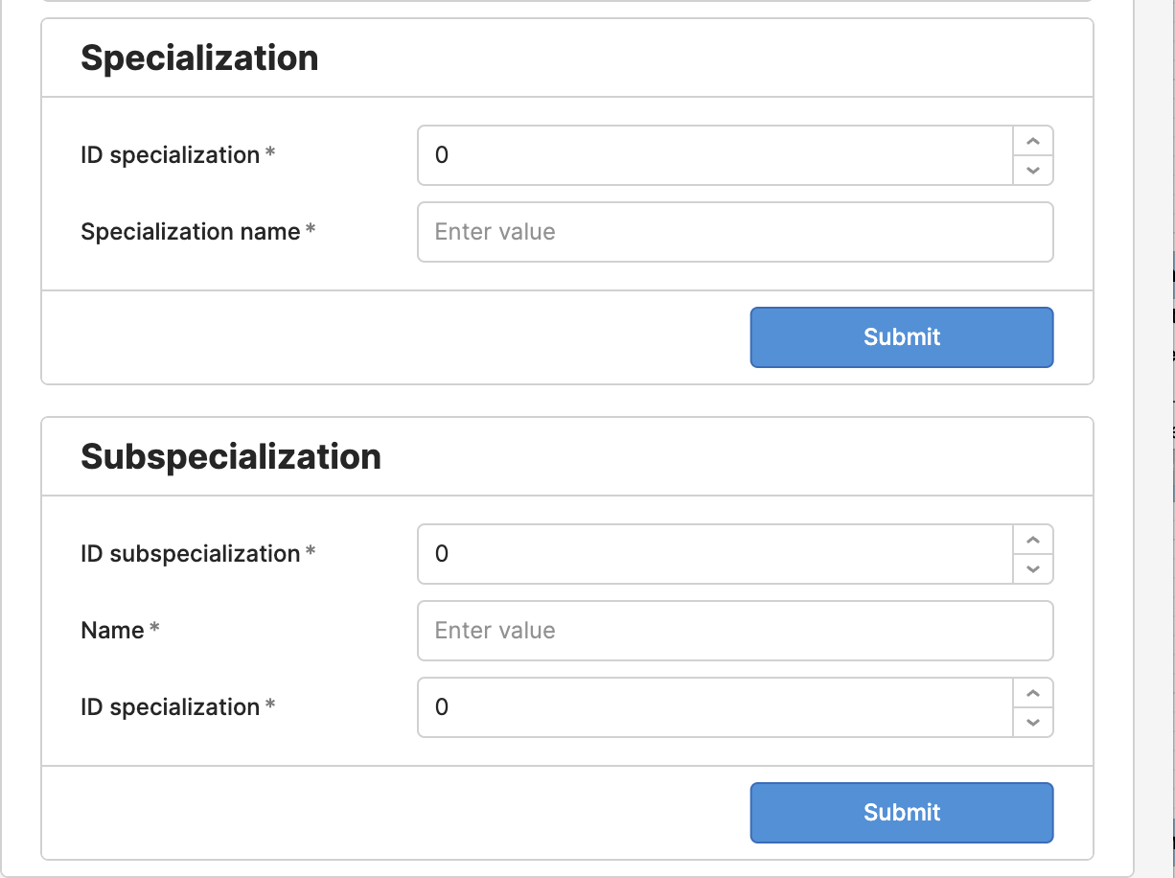

Slide 24
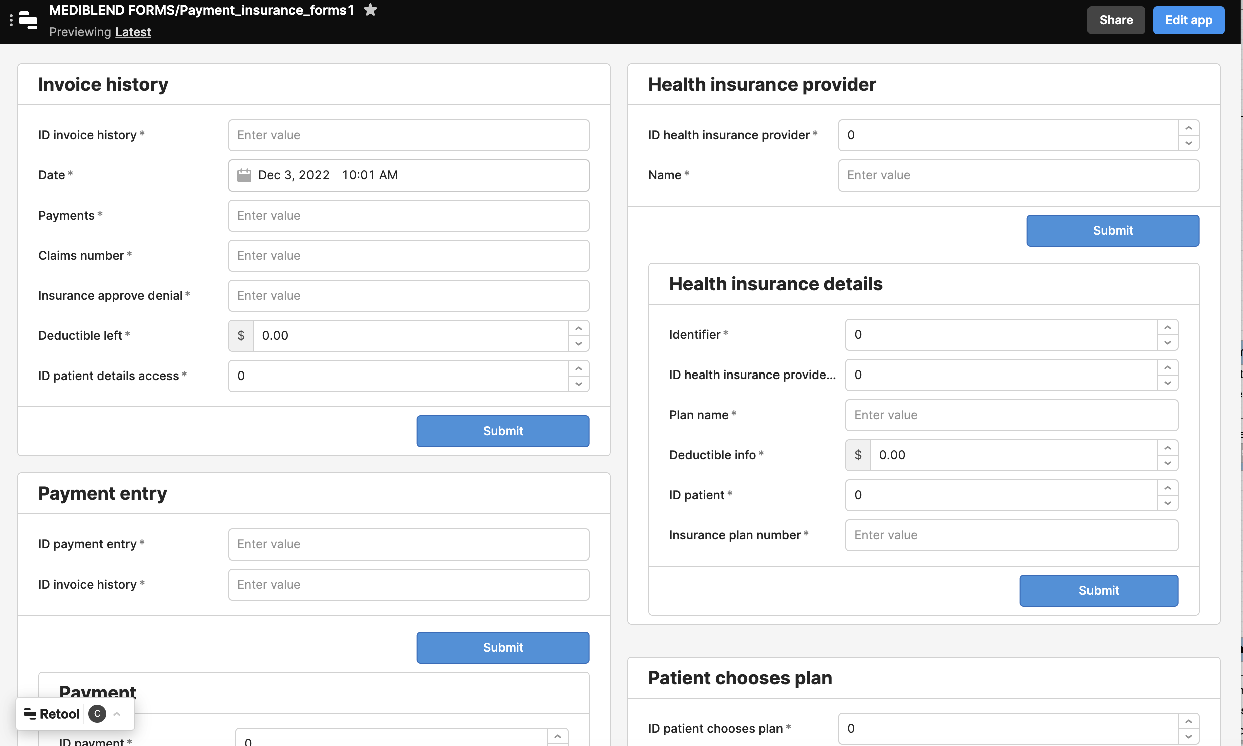

Slide 25
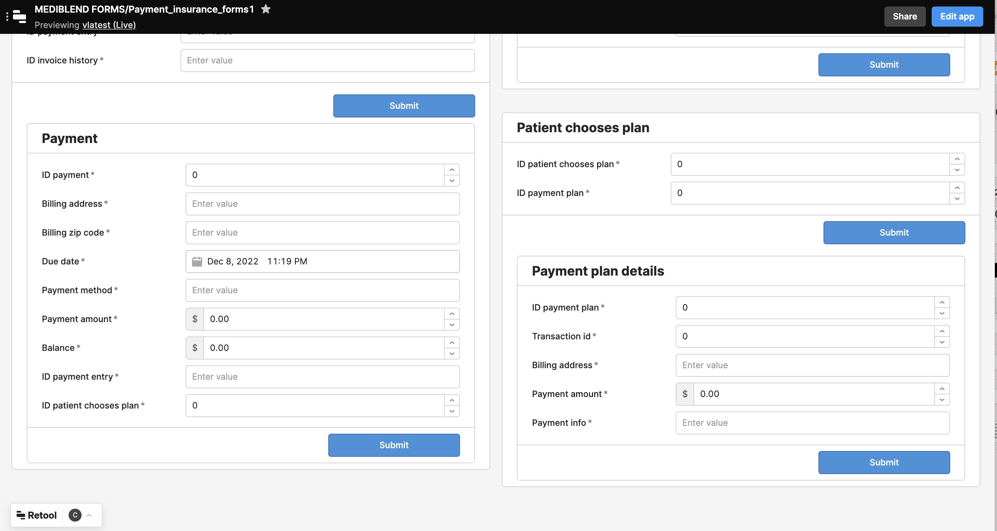

Slide 26
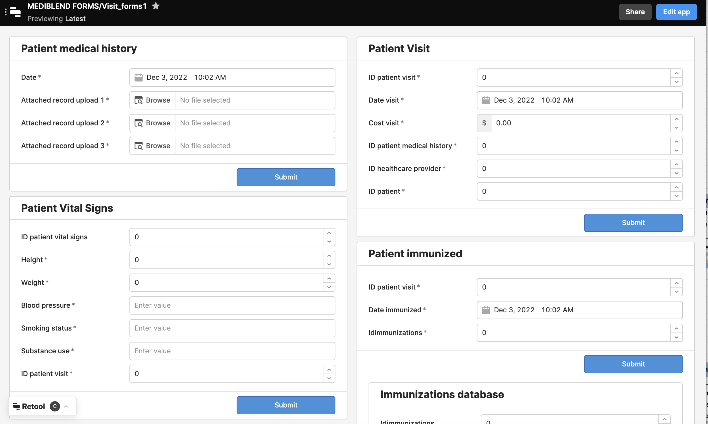
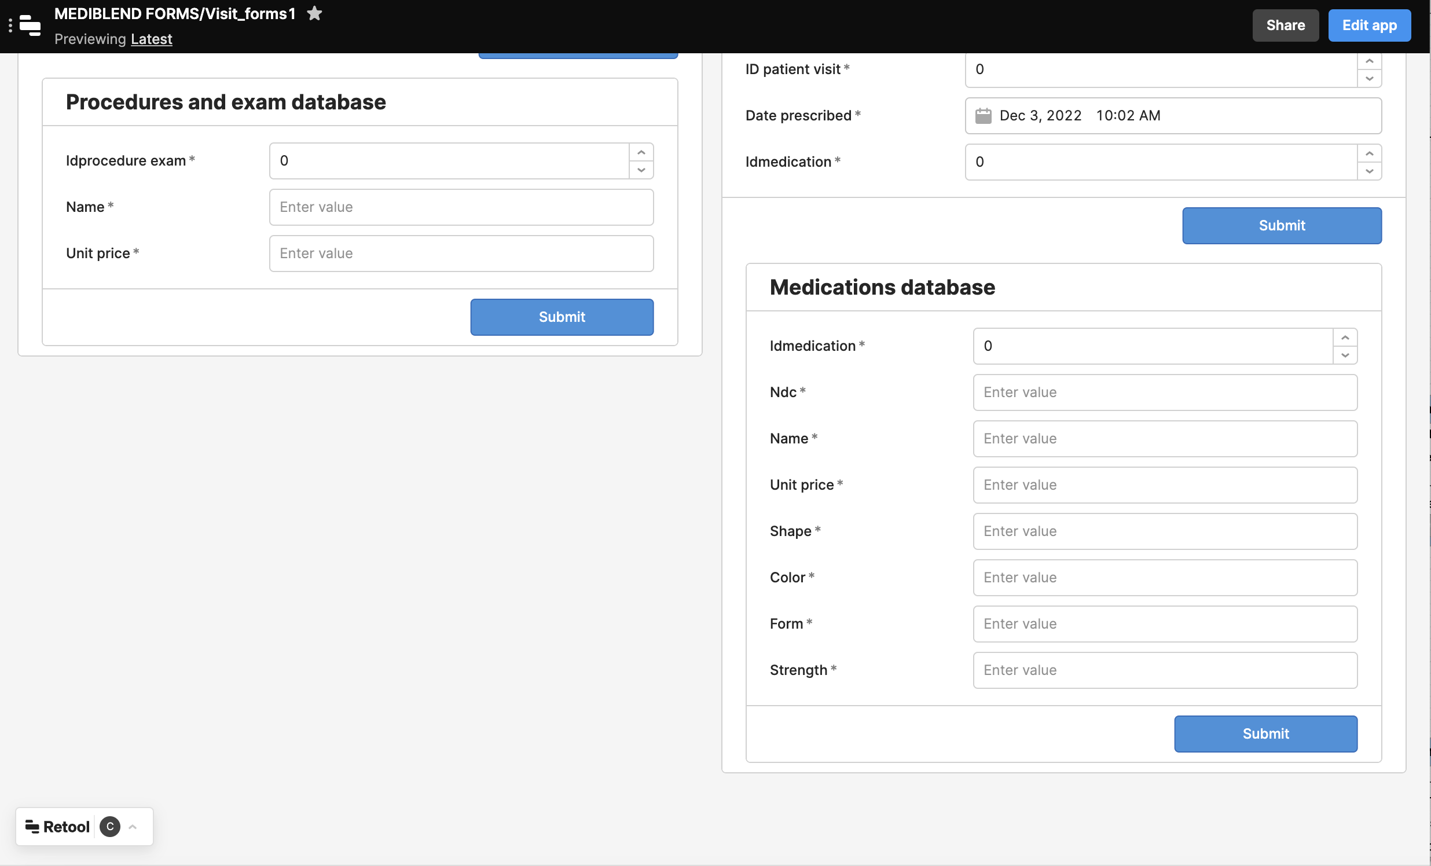
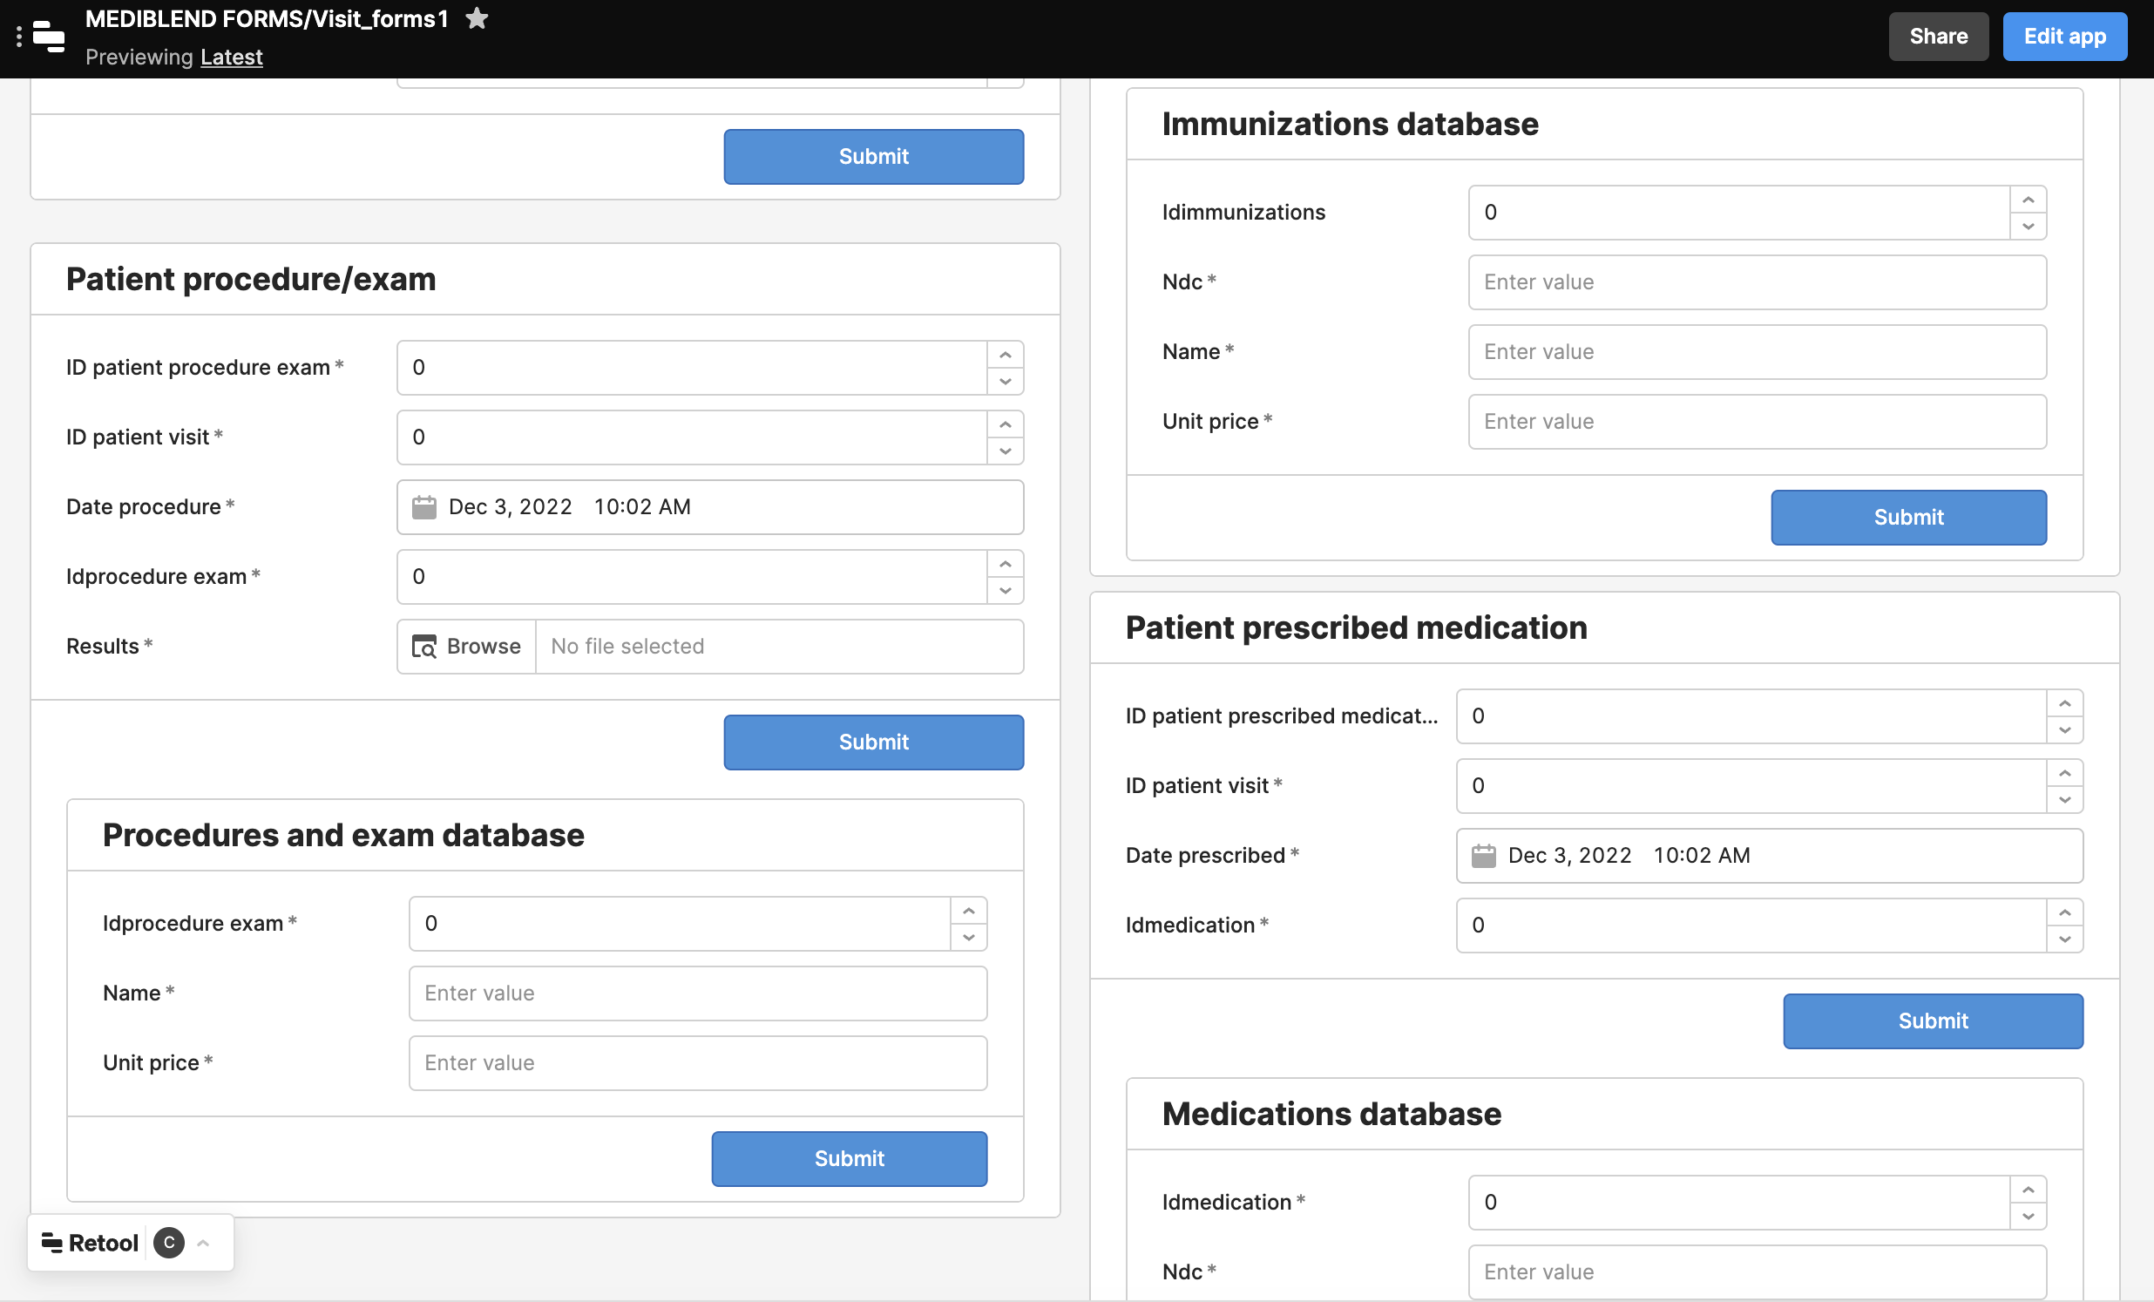

Slide 27
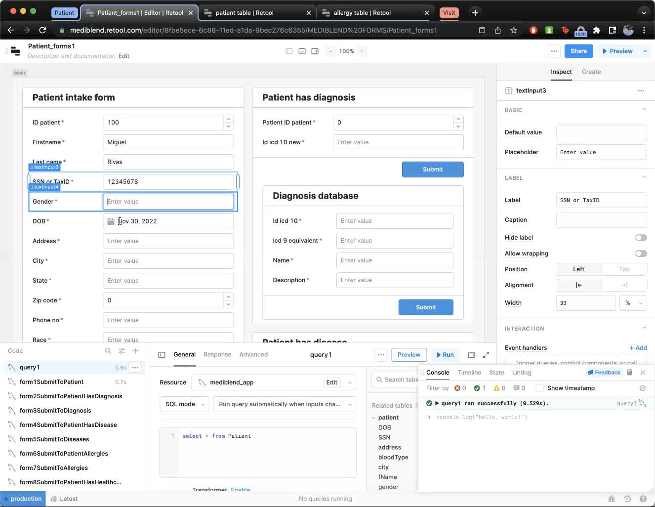
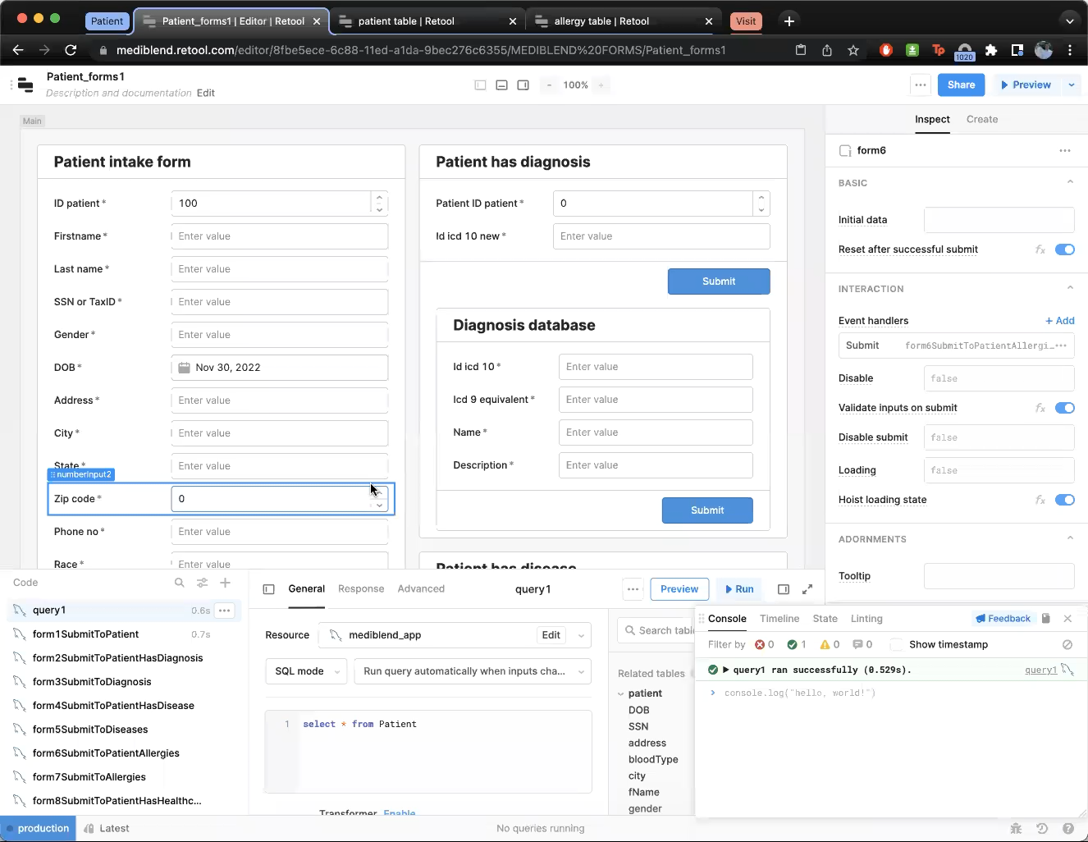
Demo
Short
Long

Slide 28
Next steps
Secure funding for app
Implement database and application audit
Pilot program for select healthcare providers and patients
Across various regions
Use feedback model to implement changes
"Customer first" approach
Improve user experience
Increases popularity among subscribers

Slide 29
Thank you

